Slide 1
PHYS1121/1131 Mechanics
Dr Jan Hamann
(substituting for A/Prof Oleg Tretiakov in Week 1)
Slides by A/Prof Yvonne Wong

Slide 2
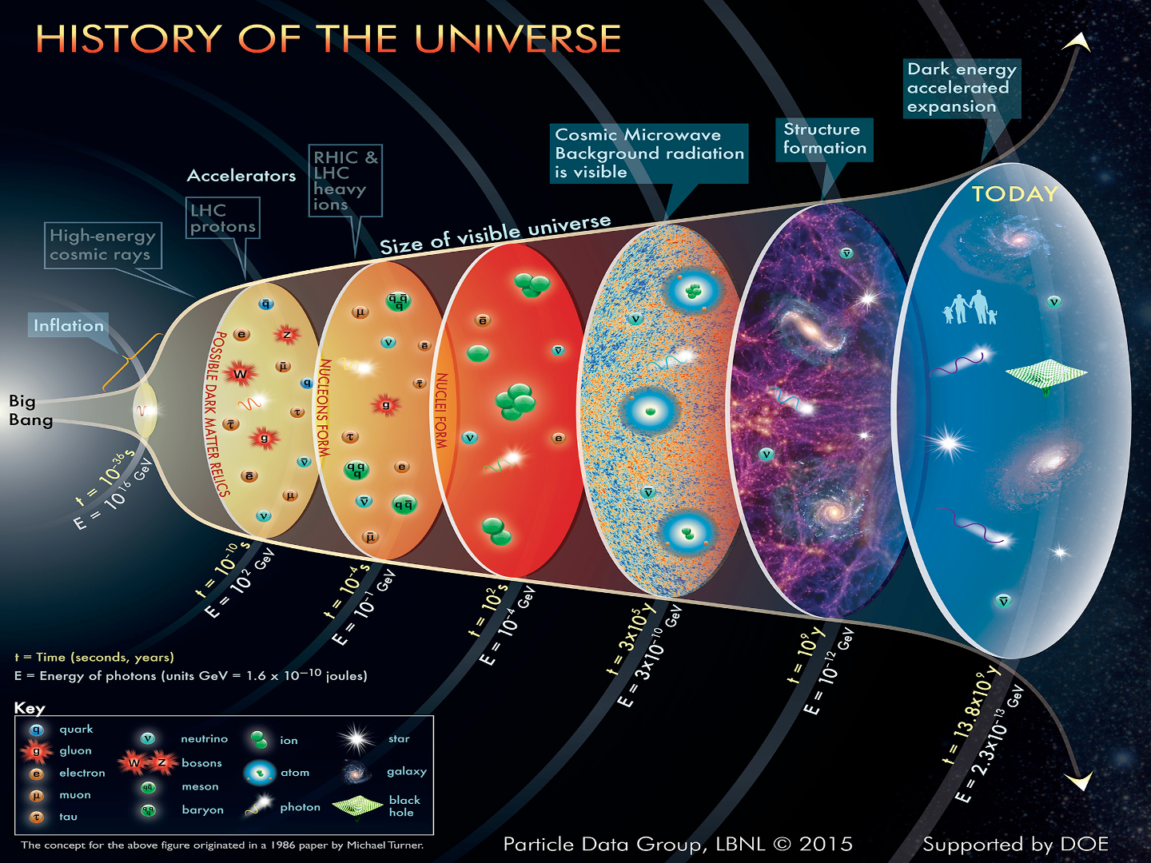
Who am I…
Dr Jan Hamann
at UNSW since 2017
Theroretical physicist
Cosmology, physics of the early Universe, data analysis, statistical methods

Slide 3
General enquiries about everything else…
Please direct all administration queries (lab, quizzes, timetable clashes, etc.) to Dr Kate Jackson (First Year Director and Course Convenor) kate.jackson1@unsw.edu.au.
I will not be able to help you at all with anything concerning lab, quizzes, timetable clashes, your enrolment; I literally do not have access to the relevant systems.
Also available for your physics queries:
Discord
PASS (Peer Assisted Study Sessions)
Forums on Moodle

Slide 4
Recommendations for time spent on this course
Each 6 UoC course at university should take 150 hrs. For this course it is recommended that each week you spend:
4 hours each week in lectures or working through web stream lectures; 2 hours in problem solving workshops; 2 hours in lab
1 hour preparing for the lab
2 hours working through the weekly quiz
3 hours completing problems from lectures/homework booklet
This leaves 20 hours at the end of term to prepare for the final exam

Slide 5
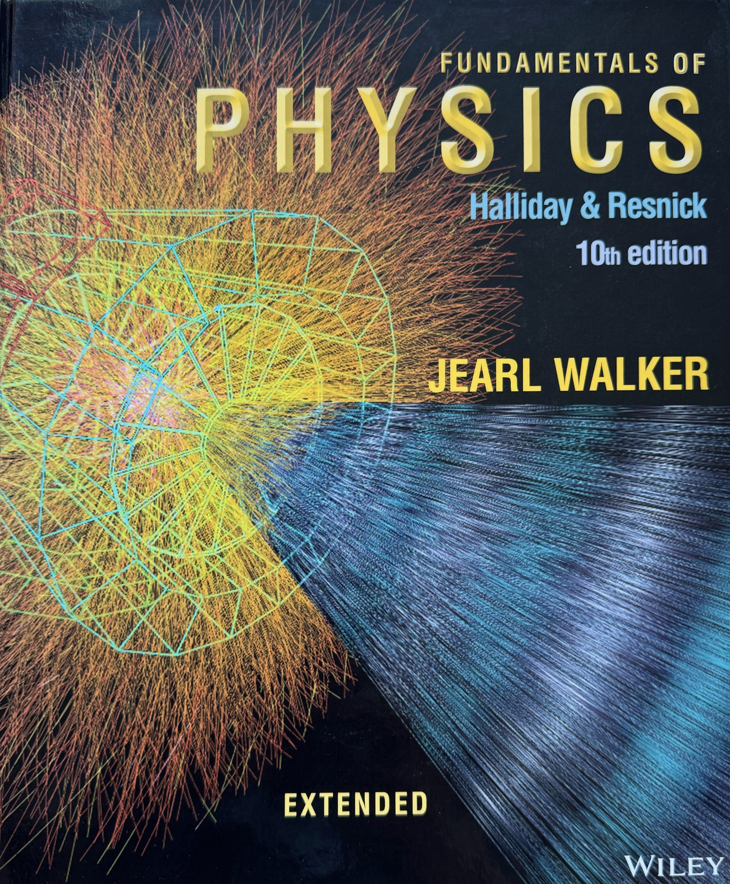
Textbook reference
Halliday, Resnick and Walker
Wiley (2013)

Slide 6
Lecture 1
Vectors and scalars; motion graphs and free fall…

Slide 7
Vectors and scalars… 1/2
y
A vector has a magnitude (“size”) and a direction.
e.g., this arrow going from point A to point B on the xy-plane.
A scalar is a quantity without a direction.
e.g., the length of this arrow, L.
y_{B}
B
L
y_{A}
A
x
x_{A}
x_{B}

Slide 8
Vectors and scalars… 2/2
y
A vector has a magnitude (“size”) and a direction.
e.g., this arrow going from point A to point B on the xy-plane.
A scalar is a quantity without a direction.
e.g., the length of this arrow, L.
y_{B}
B
L
y_{A}
A
x
x_{A}
x_{B}
Question: Identify if the following quantities are vectors:
Temperature, mass, velocity, time, distance, displacement

Slide 9
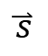
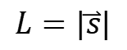
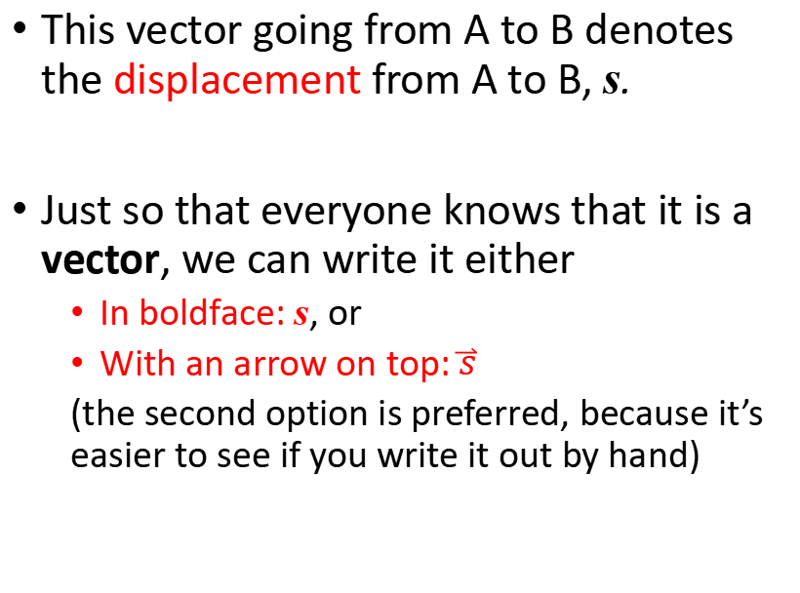
Writing vectors in unit vector notation… 1/5
This vector going from A to B denotes the displacement from A to B, s.
Just so that everyone knows that it is a vector, we can write it either
In boldface: s, or
With an arrow on top: $\overset{⃑}{s}$
(the second option is preferred, because it’s easier to see if you write it out by hand)
y_{B}
B
$$\overset{⃑}{s}$$
$$L=|\overset{⃑}{s}|$$
y_{A}
A
x
x_{A}
x_{B}

Slide 10



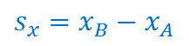
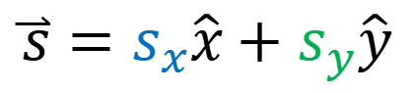
Writing vectors in unit vector notation… 2/5
This displacement vector from A to B can be expressed as:
$$\hat{y}$$
y
y_{B}
B
x-component
y-component
$$\hat{x}$$
$$\overset{⃑}{s}=s_{x}\hat{x}+s_{y}\hat{y}$$
$$\overset{⃑}{s}$$
$$s_{y}=y_{B}−y_{A}$$
$$L=|\overset{⃑}{s}|$$
y_{A}
A
“In the x-direction”
“In the y-direction”
x
x_{A}
x_{B}
$$s_{x}=x_{B}−x_{A}$$

Slide 11
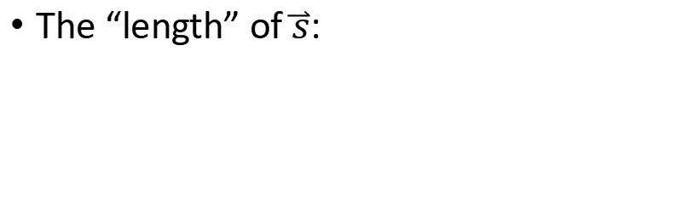
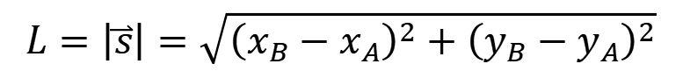
Writing vectors in unit vector notation… 3/5
This displacement vector from A to B can be expressed as:
$$\hat{y}$$
y
y_{B}
B
x-component
y-component
$$\hat{x}$$
$$\overset{⃑}{s}=s_{x}\hat{x}+s_{y}\hat{y}$$
$$\overset{⃑}{s}$$
$$s_{y}=y_{B}−y_{A}$$
$$L=|\overset{⃑}{s}|$$
y_{A}
A
“In the x-direction”
“In the y-direction”
The “length” of $\overset{⃑}{s}$:
x
x_{A}
x_{B}
$$L=\left|\overset{⃑}{s}\right|=\sqrt{{\left(x_{B}−x_{A}\right)}^{2}+{\left(y_{B}−y_{A}\right)}^{2}}$$
$$s_{x}=x_{B}−x_{A}$$

Slide 12
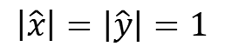
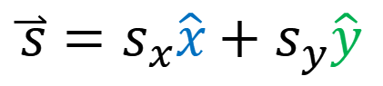
Writing vectors in unit vector notation… 4/5
This displacement vector from A to B can be expressed as:
$$\hat{y}$$
y
y_{B}
B
x-component
y-component
$$\hat{x}$$
$$\overset{⃑}{s}=s_{x}\hat{x}+s_{y}\hat{y}$$
$$\overset{⃑}{s}$$
$$L=|\overset{⃑}{s}|$$
Unit vector
in the x-direction
Unit vector
in the y-direction
y_{A}
A
A unit vector has length = 1 and is conventionally written with a “hat” on top.
x
x_{A}
x_{B}
$$\left|\hat{x}\right|=\left|\hat{y}\right|=1$$

Slide 13
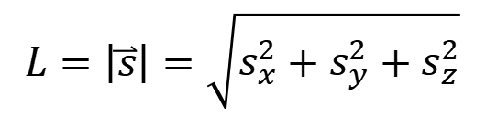



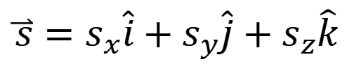
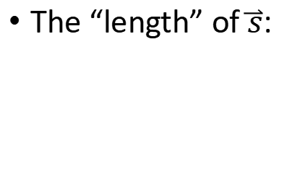
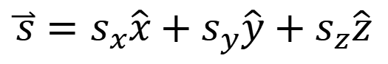
Writing vectors in unit vector notation… 5/5
Generalising to 3 dimensions:
$$\hat{k}$$
z
$$\overset{⃑}{s}=s_{x}\hat{x}+s_{y}\hat{y}+s_{z}\hat{z}$$
$$\hat{j}$$
It does not matter which notation you use. But once you’ve picked one, stick with it throughout a calculation.
$$\overset{⃑}{s}$$
$$\hat{i}$$
Or equivalently
$$\overset{⃑}{s}=s_{x}\hat{i}+s_{y}\hat{j}+s_{z}\hat{k}$$
y
The “length” of $\overset{⃑}{s}$:
$$L=\left|\overset{⃑}{s}\right|=\sqrt{s_{x}^{2}+s_{y}^{2}+s_{z}^{2}}$$
x

Slide 14
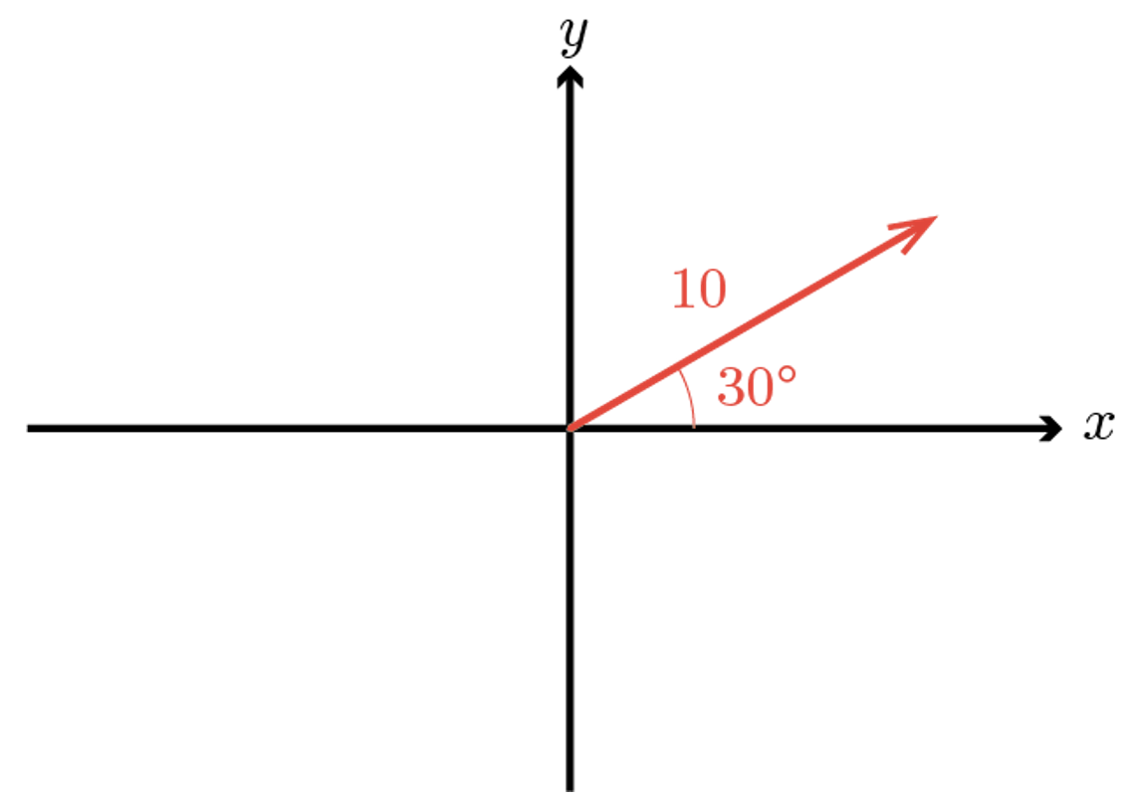

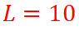
Example 1.1… 1/3
Represent the vector shown in the diagram in unit vector notation.
$$L=10$$
$$θ=30°$$

Slide 15
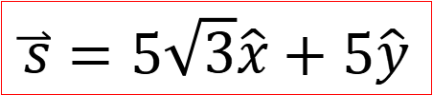
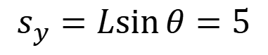
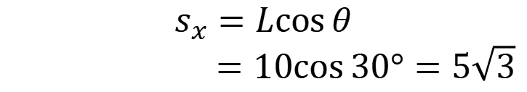
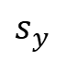
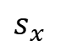
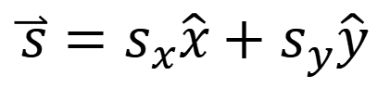
Example 1.1… 2/3
Represent the vector shown in the diagram in unit vector notation.
$$\overset{⃑}{s}=s_{x}\hat{x}+s_{y}\hat{y}$$
$$s_{x}=L\cos{θ}$$
$=10\cos{30°}=5\sqrt{3}$
$$s_{y}=L\sin{θ}=5$$
$$s_{y}$$
$$L=10$$
$$θ=30°$$
$$\overset{⃑}{s}=5\sqrt{3}\hat{x}+5\hat{y}$$
$$s_{x}$$

Slide 16
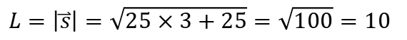
Example 1.1… 3/3
Represent the vector shown in the diagram in unit vector notation.
$$\overset{⃑}{s}=s_{x}\hat{x}+s_{y}\hat{y}$$
$$s_{x}=L\cos{θ}$$
$=10\cos{30°}=5\sqrt{3}$
$$s_{y}=L\sin{θ}=5$$
$$s_{y}$$
$$L=10$$
$$θ=30°$$
$$\overset{⃑}{s}=5\sqrt{3}\hat{x}+5\hat{y}$$
$$s_{x}$$
Check to see that it all makes sense:
$L=\left|\overset{⃑}{s}\right|=\sqrt{25×3+25}=\sqrt{100}=10$
😀

Slide 17
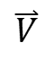
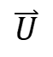

Adding vectors… 1/2
What is $\overset{⃑}{U}+\overset{⃑}{V}=\overset{⃑}{W}$?
y
$$\overset{⃑}{V}$$
Head
$$\overset{⃑}{U}$$
Tail
x

Slide 18
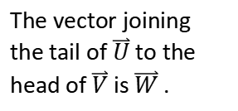
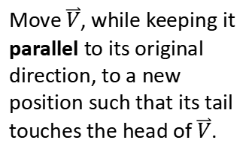
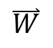
Adding vectors… 2/2
What is $\overset{⃑}{U}+\overset{⃑}{V}=\overset{⃑}{W}$?
Move $\overset{⃑}{V}$, while keeping it parallel to its original direction, to a new position such that its tail touches the head of $\overset{⃑}{V}$.
y
$$\overset{⃑}{V}$$
$$\overset{⃑}{V}$$
Head
$$\overset{⃑}{U}$$
The vector joining the tail of $\overset{⃑}{U}$ to the head of $\overset{⃑}{V}$ is $\overset{⃑}{W}$ .
$$\overset{⃑}{U}$$
$$\overset{⃑}{W}$$
Tail
x

Slide 19

Subtracting vectors… 1/3
What is $\overset{⃑}{U}−\overset{⃑}{V}=\overset{⃑}{S}$?
y
$$\overset{⃑}{V}$$
Head
$$\overset{⃑}{U}$$
Tail
x

Slide 20
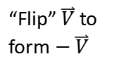
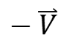
Subtracting vectors… 2/3
What is $\overset{⃑}{U}−\overset{⃑}{V}=\overset{⃑}{S}$? This is technically the same as $\overset{⃑}{U}+(−\overset{⃑}{V})=\overset{⃑}{S}$.
y
$$\overset{⃑}{V}$$
$$−\overset{⃑}{V}$$
Head
$$\overset{⃑}{U}$$
“Flip” $\overset{⃑}{V}$ to form $−\overset{⃑}{V}$
Tail
x

Slide 21
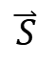
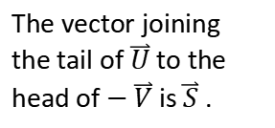
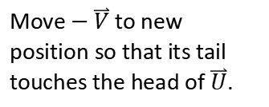
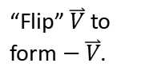
Subtracting vectors… 3/3
What is $\overset{⃑}{U}−\overset{⃑}{V}=\overset{⃑}{S}$? This is technically the same as $\overset{⃑}{U}+(−\overset{⃑}{V})=\overset{⃑}{S}$.
y
$$\overset{⃑}{V}$$
$$−\overset{⃑}{V}$$
Move $−\overset{⃑}{V}$ to new position so that its tail touches the head of $\overset{⃑}{U}$.
Head
$$−\overset{⃑}{V}$$
$$\overset{⃑}{U}$$
“Flip” $\overset{⃑}{V}$ to form $−\overset{⃑}{V}$.
The vector joining the tail of $\overset{⃑}{U}$ to the head of $−\overset{⃑}{V}$ is $\overset{⃑}{S}$ .
$$\overset{⃑}{U}$$
$$\overset{⃑}{S}$$
Tail
x

Slide 22
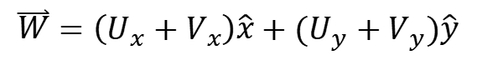
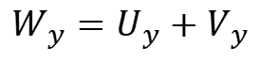
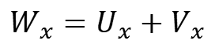
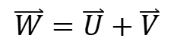
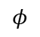
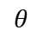
Adding and subtracting by components…
You can also work directly with the components of the vectors.
y
$$\overset{⃑}{V}$$
$$\overset{⃑}{W}=\overset{⃑}{U}+\overset{⃑}{V}$$
$$φ$$
x-component:
$$W_{x}=U_{x}+V_{x}$$
y-component:
$$W_{y}=U_{y}+V_{y}$$
$$\overset{⃑}{U}$$
$$\overset{⃑}{W}=\left(U_{x}+V_{x}\right)\hat{x}+(U_{y}+V_{y})\hat{y}$$
$$θ$$
x

Slide 23
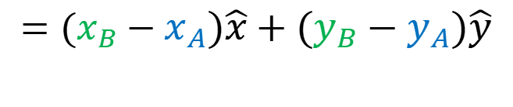
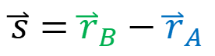


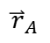
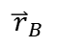
Displacement again…
The positions of A and B are described by the position vectors (relative to the origin):
y
y_{B}
B
$${\overset{⃑}{r}}_{A}=x_{A}\hat{x}+y_{A}\hat{y}$$
$${\overset{⃑}{r}}_{B}$$
$$\overset{⃑}{s}$$
$${\overset{⃑}{r}}_{B}=x_{B}\hat{x}+y_{B}\hat{y}$$
y_{A}
A
The displacement from A to B is:
$${\overset{⃑}{r}}_{A}$$
0
x
$$\overset{⃑}{s}={\overset{⃑}{r}}_{B}−{\overset{⃑}{r}}_{A}$$
x_{A}
x_{B}
$$=(x_{B}−x_{A})\hat{x}+(y_{B}−y_{A})\hat{y}$$

Slide 24
Displacement vs distance…
It is important to remember that displacement is a vector. It describes the change in the position of an object (e.g., moving from the point A to the point B).
Distance, on the other hand, is the total path length along which the object travels.
y
y_{B}
B
$$\overset{⃑}{s}$$
y_{A}
A
0
x
x_{A}
x_{B}

Slide 25
Example 1.2… 1/2
A particle travels around a circle with radius r. If it travels exactly once around the circle,
What is the distance travelled?
What is its displacement?

Slide 26
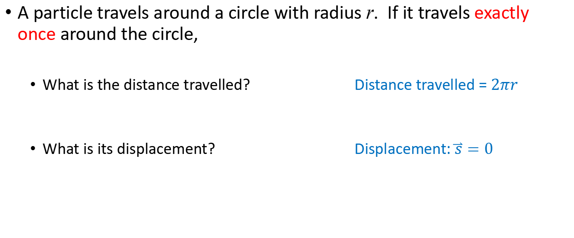
Example 1.2… 2/2
A particle travels around a circle with radius r. If it travels exactly once around the circle,
What is the distance travelled? Distance travelled = $2πr$
What is its displacement? Displacement: $\overset{⃑}{s}=0$

Slide 27
Example 1.3… 1/3
A boy walks 10 m north and then 5 m south.
What is his displacement?
What is the distance travelled?

Slide 28
Example 1.3… 2/3
A boy walks 10 m north and then 5 m south.
What is his displacement?
What is the distance travelled?
North
5 m
10 m
South

Slide 29
Example 1.3… 2/3
Don’t forget to specify the direction!
A boy walks 10 m north and then 5 m south.
What is his displacement? Displacement = 5 m north
What is the distance travelled? Distance = 15 m
North
5 m
10 m
South

Slide 30
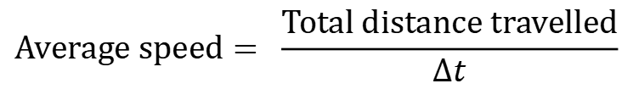
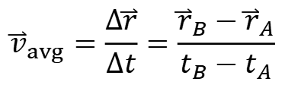
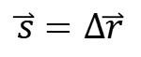
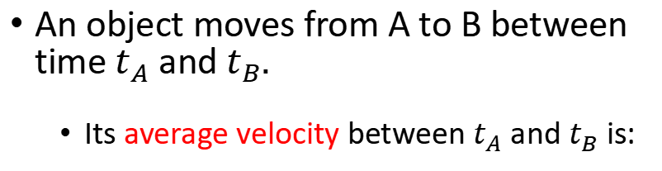
Average velocity and speed…
An object moves from A to B between time $t_{A}$ and $t_{B}.$
Its average velocity between $t_{A}$ and $t_{B}$is:
y
y_{B}
B
$${\overset{⃑}{v}}_{avg}=\frac{∆\overset{⃑}{r}}{∆t}=\frac{{\overset{⃑}{r}}_{B}−{\overset{⃑}{r}}_{A}}{t_{B}−t_{A}}$$
$$\overset{⃑}{s}=∆\overset{⃑}{r}$$
Its average speed is:
y_{A}
$${\overset{⃑}{r}}_{B}$$
A
$$Average speed= \frac{Total distance travelled}{Δt}$$
$${\overset{⃑}{r}}_{A}$$
0
x
x_{A}
x_{B}

Slide 31
Average velocity and speed…
An object moves from A to B between time $t_{A}$ and $t_{B}.$
Its average velocity between $t_{A}$ and $t_{B}$is:
y
y_{B}
B
$${\overset{⃑}{v}}_{avg}=\frac{∆\overset{⃑}{r}}{∆t}=\frac{{\overset{⃑}{r}}_{B}−{\overset{⃑}{r}}_{A}}{t_{B}−t_{A}}$$
$$\overset{⃑}{s}=∆\overset{⃑}{r}$$
Its average speed is:
y_{A}
$${\overset{⃑}{r}}_{B}$$
A
$$Average speed= \frac{Total distance travelled}{Δt}$$
$${\overset{⃑}{r}}_{A}$$
0
x
x_{A}
x_{B}
Question: Is the magnitude of ${\overset{⃑}{v}}_{avg}$always the same as the average speed?

Slide 32


Instantaneous velocity and speed…
Pick a point P along the object’s path and displace the object by an infinitesimal $Δ\overset{⃑}{r}$ in time interval $∆t$ towards B.
y
y_{B}
B
P
$$\overset{⃑}{r}$$
y_{A}
A
0
x
x_{A}
x_{B}

Slide 33

Instantaneous velocity and speed…
Pick a point P along the object’s path and displace the object by an infinitesimal $Δ\overset{⃑}{r}$ in time interval $∆t$ towards B.
y
y_{B}
B
$$Δ\overset{⃑}{r}$$
P
$$\overset{⃑}{r}$$
y_{A}
A
0
x
x_{A}
x_{B}

Slide 34



Instantaneous velocity and speed…
Pick a point P along the object’s path and displace the object by an infinitesimal $Δ\overset{⃑}{r}$ in time interval $∆t$ towards B.
The object’s instantaneous velocity at P is:
y
y_{B}
B
$$Δ\overset{⃑}{r}$$
P
“…|_{p}” means you need to evaluate this expression at point P.
$$\overset{⃑}{r}$$
$${\left.\overset{⃑}{v}\right|}_{P}=\lim_{∆t→0}{{\left.\frac{∆\overset{⃑}{r}}{∆t}\right|}_{P}=}{\left.\frac{d\overset{⃑}{r}}{dt}\right|}_{P}$$
y_{A}
A
0
x
Its instantaneous speed at P is:
x_{A}
x_{B}
$$instantaneous speed=\left|\overset{⃑}{v}\right|$$
I have dropped the subscript P here because it’s understood.

Slide 35


Example 1.4… 1/2
A particle moves along the x-axis. Its position is described by:
$$x=5+2t − t^{2}$$
t is in time in units of seconds
x is position in units of metres
What is its displacement between $t=0 s$ and $t=5 s$?
What distance does it travel between $t=0 s$ and $t=5 s$?
What is its average velocity in this time period?
What is its instantaneous velocity at $t=0 s$ and $t=5 s$?

Slide 36






Example 1.4… 2/2
A particle moves along the x-axis. Its position is described by:
$$x=5+2t − t^{2}$$
t is in time in units of seconds
x is position in units of metres
What is its displacement between $t=0 s$ and $t=5 s$?
What distance does it travel between $t=0 s$ and $t=5 s$?
What is its average velocity in this time period?
What is its instantaneous velocity at $t=0 s$ and $t=5 s$?
$$−10 m \hat{x}−5 m \hat{x}=−15 m \hat{x}$$
$$\left(1+16\right) m=17 m$$
$$−15 m \hat{x}/ 5 s =−3 m/s \hat{x}$$
$$\frac{dx}{dt}=2−2 t$$
$$2 m/s \hat{x}$$
$$−8 m/s \hat{x}$$

Slide 37

A word about units…
Measurements of physical quantities must be specified together with their associated units. This is of utmost importance.
e.g., if in the previous examples,
$$x=5+2t − t^{2}$$
I had told you that time t in this equation had units of minutes instead of seconds, your answers would have been completely different!
New answers: (i) $0.16 m \hat{x}$, (ii) $0.16 m$, (iii) $0.032 m/s \hat{x}$, and (iv) $0.033 m/s \hat{x}$, $0.031 m/s \hat{x}$.
Old answers: (i) $−15 m \hat{x}$, (ii) $17 m$, (iii) $−3 m/s \hat{x}$, and (iv) $2 m/s \hat{x}$, $−8 m/s \hat{x}$.

Slide 38

SI units: Base units and derived units…
SI units = Le Système international d’unités
There are seven SI base units.
All other units can be derived from these seven base units, e.g.,
Velocity: m/s
Acceleration: m/s²
Notes:
Show meter ruler, get them to estimate 10 s.

Slide 39

Prefixes for SI units…
Prefix | Symbol | Factor | power
tera | T | 1 000 000 000 000 | 10¹²
giga | G | 1 000 000 000 | 10⁹
mega | M | 1 000 000 | 10⁶
kilo | k | 1 000 | 10³
none |  | 1 | 1
centi | c | 0.01 | 10⁻²
milli | m | 0.001 | 10⁻³
micro | $$μ$$ | 0.000001 | 10⁻⁶
nano | n | 0.000000001 | 10⁻⁹
pico | p | 0.000000000001 | 10⁻¹²
Question: How many cm in 1 km?

Slide 40

Significant figures… 1/4
The number of significant figures in the measured value of a quantity is the number of digits in that number that are reliable.
How long is the red line?
Using the top ruler, we can only say it is 8 cm long. You might think it looks like 8.3 cm. But that 0.3 cm is unreliable; it’s a guess. Thus, this measurement has 1 significant figure only.
Using the bottom ruler, we can say 8.2 cm reliably. This number has 2 significant figures.

Slide 41
Significant figures… 2/4
Question: How many significant figures does each of these numbers have?
55, 30, 121, 500, 22.3

Slide 42

Significant figures… 3/4
The way we write numbers can sometimes make the significant figures in a number ambiguous.
The Eiffel Tower is said to be 330 m tall.
Is it really 330 m to the metre, or
Do I mean something between 325 m to 334m?

Slide 43


Significant figures… 4/4
The way we write numbers can sometimes make the significant figures in a number ambiguous.
The Eiffel Tower is said to be 330 m tall.
Is it really 330 m to the metre, or
Do I mean something between 325 m to 334m?
The way around this ambiguity is to use scientific notation:
2 significant figures
$$3.3×{10}^{2} m$$
As it turns out, the height of the Eiffel Tower really is 3.30 x 10² m.
3 significant figures
$$3.30×{10}^{2} m$$

Slide 44
Significant figures in calculations…. 1/2
When presenting the result of a calculation, always give your answer with the same number of significant figures as the piece of data used in the calculation with the least number of significant figures.
Notes:
Would be good to update video of this one. So many mistakes…

Slide 45
Significant figures in calculations…. 2/2
When presenting the result of a calculation, always give your answer with the same number of significant figures as the piece of data used in the calculation with the least number of significant figures.
Question: How many significant figures do you answer this question to?
A car travels northwards at 62 km/h for 51 minutes then in an easterly direction at 55.5 km/h for 15 minutes. What is its displacement in m?
Notes:
Would be good to update video of this one. So many mistakes…

Slide 46


Displacement, velocity, and acceleration…
Consider a moving object.
Its position with time t relative to its original position at $t=0$ is called the displacement, $\overset{⃑}{r}(t)$.
The velocity of the object is the rate of change of its displacement.
Its acceleration is the rate of change of its velocity.
y
y_{B}
B
$$\overset{⃑}{r}(t)$$
y_{A}
A
0
x
x_{A}
x_{B}

Slide 47
Displacement vs time graph…
A useful device to show the position of an object relative to its original position as a function of time.
[m]
[s]

Slide 48



Velocity from displacement vs time graph. 1/3
Velocity is the gradient in a displacement vs time graph:
[m]
$\overset{⃑}{v}=\frac{Δ\overset{⃑}{r}}{Δt}$
Or in the 1D case:
$\overset{⃑}{v}=\frac{Δx}{Δt}\hat{x}$
The instantaneous velocity is the gradient of the curve at the point of interest; $\frac{Δx}{Δt}→\frac{dx}{dt}$
The average velocity over a specified period is the average gradient over that period.
[s]

Slide 49

Velocity from displacement vs time graph. 2/3
Velocity is the gradient in a displacement vs time graph:
[m]
$\overset{⃑}{v}=\frac{Δ\overset{⃑}{r}}{Δt}$
Or in the 1D case:
$\overset{⃑}{v}=\frac{Δx}{Δt}\hat{x}$
Question: What is the
Instantaneous velocity at $t=1s,6s,8s$?
Average velocity over the ten second period?
[s]

Slide 50


Velocity from displacement vs time graph. 3/3
Velocity is the gradient in a displacement vs time graph:
[m]
$\overset{⃑}{v}=\frac{Δ\overset{⃑}{r}}{Δt}$
Or in the 1D case:
$\overset{⃑}{v}=\frac{Δx}{Δt}\hat{x}$
Question: What is the
Instantaneous velocity at $t=1s,6s,8s$?
Average velocity over the ten second period?
$$\overset{⃑}{v}=(1, 0,7/3) m/s \hat{x}$$
[s]
$${\overset{⃑}{v}}_{avg}=1m/s \hat{x}$$

Slide 51
Velocity vs time graph…
You can of course also plot the velocity of an object against time.
[m/s]
[s]
Notes:
Start here stream A 2023.

Slide 52



Acceleration from velocity vs time graph…
Acceleration is the gradient in a velocity vs time graph:
$\overset{⃑}{a}=\frac{Δ\overset{⃑}{v}}{Δt}$
Or in the 1D case:
$\overset{⃑}{a}=\frac{Δv_{x}}{Δt}\hat{x}$
[m/s]
The instantaneous acceleration is the gradient of the curve at the point of interest; $\frac{Δv_{x}}{Δt}→\frac{dv_{x}}{dt}$
The average acceleration over a specified period is the average gradient over that period.
[s]

Slide 53

Example 1.5… 1/2
A particle moves along the x-axis. Its position is described by:
$$x=5+2t − t^{2}$$
t is in time in units of seconds
x is position in units of metres
What is its instantaneous velocity at $t=0 s$ and $t=5 s$?
What is its instantaneous acceleration at $t=0 s$ and $t=5 s$?
What is its average acceleration between $t=0 s$ and $t=5 s$?

Slide 54





Example 1.5… 2/2
A particle moves along the x-axis. Its position is described by:
$$x=5+2t − t^{2}$$
t is in time in units of seconds
x is position in units of metres
What is its instantaneous velocity at $t=0 s$ and $t=5 s$?
What is its instantaneous acceleration at $t=0 s$ and $t=5 s$?
What is its average acceleration between $t=0 s$ and $t=5 s$?
$$v_{x}=\frac{dx}{dt}=2−2 t$$
$$v_{x}\left(0\right)=2 m/s$$
$$v_{x}\left(5\right)=−8 m/s$$
$$a_{x}=\frac{dv_{x}}{dt}=\frac{d^{2}x}{dt^{2}}=−2 m/s^{2}$$
$$a_{avg}=\frac{v_{x}\left(5\right)−v_{x}\left(0\right)}{\left(5−0\right) s}=−2 m/s^{2}$$

Slide 55


Displacement from velocity vs time graph…
It also works the other way: displacement is the area under an instantaneous velocity vs time graph.
[m/s]
Or equivalently, an object’s displacement between $t=t_{1}$ and $t=t_{2}$ is given by the integral:
$$x\left(t_{2}\right)−x(t_{1})=\int_{t_{1}}^{t_{2}}{{dt v}_{x}(t)}$$
[s]

Slide 56
Velocity vs time graphs…
Question: Suppose you know the velocity of an object as a function of time (via an expression, or a velocity vs time graph). Which of the following quantities can be obtained from this information?
[m/s]
Initial position
Initial speed
Initial acceleration
Total distance travelled
Total displacement
Average acceleration
[s]
Notes:
Have a student model it out…

Slide 57
Example 1.6… 1/3
Using this velocity vs time graph:
Draw the displacement vs time
Draw the acceleration vs time
[m/s]
[s]
Notes:
Start here stream A 2023.

Slide 58




Example 1.6… 2/3
Using this velocity vs time graph:
Draw the displacement vs time
Draw the acceleration vs time
[m/s]
$$v_{x}=1$$
$$v_{x}=t−1$$
$$v_{x}=−0.5\left(t−4\right)+1$$
[s]
$$v_{x}=0$$
Notes:
Start here stream A 2023.

Slide 59


Example 1.6… 3/3
Displacement vs time
Acceleration vs time
Notes:
Start here stream A 2023.

Slide 60


Example 1.7… 1/2
The velocity of an object is given by:
$$v(t)=5−t$$
t is in time in units of s
v is velocity in units of m/s
The object starts from the position $x=2 m$.
Sketch a velocity vs time graph from $t=0 s$ to $t=10 s$.
Write an expression for the displacement of the object.
Sketch an acceleration vs time graph.
Describe in words the motion of this object over the 10 seconds.

Slide 61




Example 1.7… 2/2
The velocity of an object is given by:
$$v(t)=5−t$$
t is in time in units of s
v is velocity in units of m/s
The object starts from the position $x=2 m$.
Sketch a velocity vs time graph from $t=0 s$ to $t=10 s$.
Write an expression for the displacement of the object.
Sketch an acceleration vs time graph.
Describe in words the motion of this object over the 10 seconds.
$$x\left(t\right)−x\left(0\right)=\int_{0}^{t}{dt(5−t)}$$
$$x\left(t\right)=−\frac{t^{2}}{2}+5t+2$$
$$a\left(t\right)=−1$$
Object decelerates and comes to a stop at $t=5 s$. From $t=5 s$, the object accelerates in the negative x-direction.

Slide 62

Free fall… 1/2
Free fall refers to the accelerated motion of an object close to the surface of the Earth due to the attractive gravitational force of the Earth.
Question: Is the acceleration $g$ constant?

Slide 63


Free fall… 2/2
PREM = Primary Reference Earth Model
The free-fall acceleration $g$ depends in principle on exactly how far an object is from the Earth’s centre.
The Earth is not exactly spherical: $g=9.78 m/{s^{2}}$ at the equator; $g=9.83 m/{s^{2}}$ at the poles.
For our purposes, it suffices to take $g=9.8 m/{s^{2}}$, as long as the object remains close to the surface of the Earth.
3 density models for the Earth.

Slide 64
Example 1.8… 1/2
Draw an acceleration, velocity and displacement graph for a ball dropped from a height of 10 m. Neglect air resistance.

Slide 65







Example 1.8… 2/2
Draw an acceleration, velocity and displacement graph for a ball dropped from a height of $y_{0}=10 m$. Neglect air resistance.
$$\hat{y}$$
$$\overset{⃑}{r}=\left(−\frac{1}{2}gt^{2}+y_{0}\right)\hat{y}$$
$$\overset{⃑}{a}=−g\hat{y}$$
$$\overset{⃑}{v}=−gt \hat{y}$$

Slide 66

Problem 1.1…
The particle shown in this graph starts from rest at the origin.
What is the initial velocity?
Sketch a velocity versus time graph.
What is its displacement at $t=3 s$?
What is its displacement between $t=3 s$ and $t= 5 s$?

Slide 67

Problem 1.2…
A jogger runs at a constant speed of $10 km/h$. They run in a northerly direction for 25 minutes and then run in a westerly direction for 35 minutes.
Give their displacement in metres in unit vector notation, with $\hat{i}$being an easterly unit vector, and $\hat{j}$ being a northerly unit vector.
What is the average velocity of the jogger?

Slide 68


Problem 1.3…
A particle moves along the x-axis. Its position is described by:
$$x\left(t\right)={2t}^{2}−7$$
t is in time in units of seconds
x is position in units of metres
What is the displacement of the particle in its first five seconds?
What distance does the particle travel in the first five seconds?
What is the average velocity of the particle in the first five seconds?
What is the instantaneous velocity of the particle at $t=0 s$ and at $t=5 s$?

Slide 69

Problem 1.4…
The displacement of an object is described by:
$$x\left(t\right)=t2 −3t+5$$
t is in time in units of seconds
x is position in units of metres
Write down an expression for the velocity of the object.
Write down an expression for the acceleration of the object.
Plot graphs showing the displacement vs time, velocity vs time, and acceleration vs time of this object.

Slide 70

Problem 1.5…
This graph shows the velocity of a car versus time.
What is the acceleration of the car at $t=30 s$?
When is the car at rest?
How far does the car travel in the $100 s$ shown on the graph?
What is the average acceleration over the $100 s$?

Slide 71

Problem 1.6…
A ball is dropped from 6.00 m in Sydney, where $g=9.80 m/s2$. Neglect air resistance.
Write down an expression for the velocity of the ball as a function of time while it falls.
Write down an expression for the height of the ball.
How long does it take the ball to reach the ground?

